Slide 1

The Uses and Features of a Website
Candidate Name: Christopher Task 1, Uses and features

Slide 2



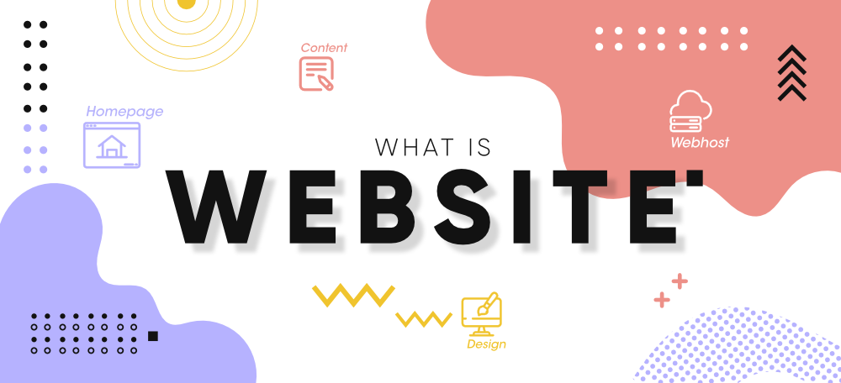
What is a Website?
A website is a set of webpages that is linked together that you can use by connecting through a webserver.
All websites begin with HTTP (Hypertext Transfer Protocol) or HTTPS (Hypertext Transfer Protocol Secure).
All websites are linked together using a top level domain name such as .com or .xyz.
Some websites you could go to include ‘https://netflix.com’, ‘https://chriswasntavailable.xyz’ ‘https://google.com’.

Slide 3







Uses of a Website
Uses of a website’s could include
Storing Information
Google Drive, iCloud, OneDrive
Searching for information
Google, Wikipedia, Bing
E-commerce
Amazon, eBay, Tesco
Downloading Information
iTunes, Cloudflare, Wikimedia
Making Decisions
Compare the Market, Money Supermarket, Confused.com
Notes:
Storing Information
Companies will let you store information on the cloud such as pictures and documents, generally companies will give you 5 – 15 GB of “free” space to store information. This is generally known as ‘The Cloud’. Example of companies that do this is Google with Google Drive & Apple with iCloud.
Searching for information
Information can be found all around the internet from ‘factual’ sources like Wikipedia.com, youtube.com on how to fix a plug or to researching different types of medical conditions.
E-commerce
From places like Amazon to eBay you can find a lot of items on the internet that you can buy such as iPhones, food items etc.
Downloading Information
You can download content from a whole range of sites such as iTunes. Most content downloads come from a websites CDN (Content Delivery Network) and a CDN is mostly comprised of servers based across the world giving out content so if a lot of people are requesting content a lot, it can hand it out without causing one webserver to be congested. An example of a popular CDN system is Cloudflare.
Making Decisions
People can make informed decisions about what to buy and what credit cards or loans to get as sites like Compare the Market have tables that say the different interest rates for different banks and loans.

Slide 4






More uses of a website
More uses of a website
Education
Sparx Maths, Google Classroom, BBC Bitesize
Communication
Instagram, WhatsApp, Snapchat
Media Sharing
Spotify, Netflix, BBC
Presenting Information
Google Docs, Microsoft Office, Libre Office
Improving Productivity
Slack, Google Docs, Gmail
Notes:
Education
It is important to both people but also the internet as you can get information from anywhere on the internet about every subject from ICT to Brick Laying.
Communication
Communication is useful and convenient in this digital age where you are a few clicks away from calling anyone that has a phone number or you can use an app like Snapchat to call people where you only need a mobile device and an email to sign up.
Media Sharing
Media sharing is useful for when you need to get content either for education or entertainment, examples of companies that do media sharing are Spotify, Netflix and BBC.
Presenting Information
Presenting Information is important to get your point across and can help in a lot of job aspects and in school with PowerPoint.
Improving Productivity Productivity can get improved by using easy tools to share information between team members using Microsoft Teams or Slack.

Slide 5
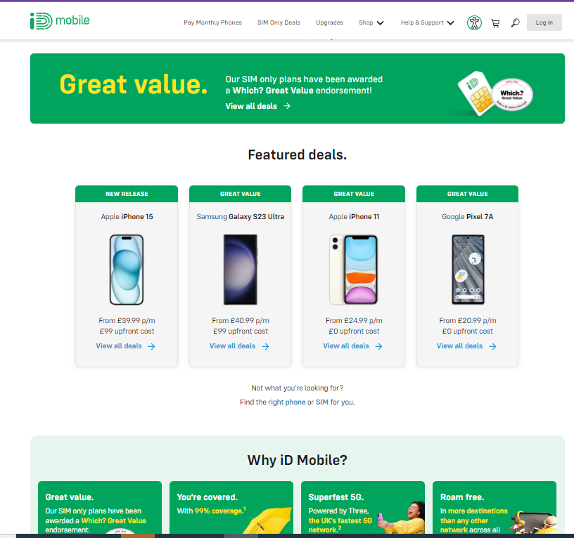

Searching For Information
Presenting Information
Communication
E-commerce
Education
iD mobile
ID Mobile is a telephone company founded in May 2012 and is owned by Currys plc.
Shown in this picture is examples of making decisions, E-commerce, education and presenting information, communication.
Making Decisions
Notes:
This site is e-commerce because it allows you to buy a physical device and/or Sim Card. This website is presenting information because it allows you to click through different pages on the website.
This website is educating me because it is showing me what phones are available.
This website is helping me to make decisions because there is a section called “Why iD Mobile?”.
This website helps me to communicate using the magnifying glass as it is the help button.

Slide 6
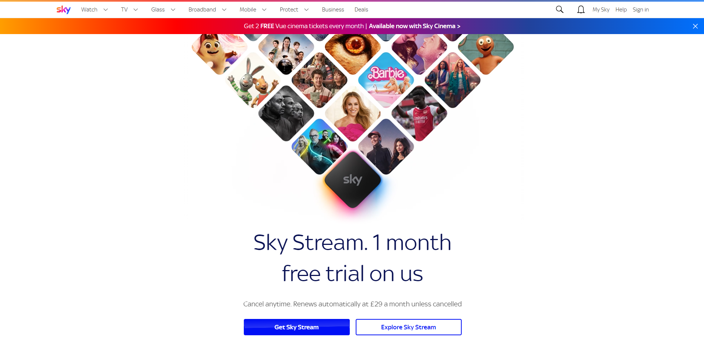

v
v
Sky, formed as British Sky Broadcasting BSkyB on 2 November 1990 is the leading role in British and European Satellite broadcasting with 23.12 Million subscribers in 2022.
Sky Group is owned by American media conglomerate Comcast.
Shown in this picture is examples of presenting information, E-commerce, Education, Make Decisions, Communication and Searching for Information.
Searching For Information
Communicate
E-commerce
Make Decisions
Education
v
Presenting Information
Notes:
This site is e-commerce because it allows you to buy a goods and services.
This website is educating me because it is showing me what the Sky Stream is.
This website is presenting information as it is showing me details about the Sky Stream. This website helps me to communicate Using Help.
This website helps me to make decisions because it has a tab which gives suggestions on what to watch.

Slide 7



Features of a Website | https://idmobile.co.uk
Hyperlinks | iD Mobile has hyperlinks at the top of their page so you can find and navigate quickly.
Action Buttons | iD Mobile has action buttons at the top and middle of their page. Action buttons are typically used to join a support chat, check your basket and to log into your account.
Template | iD Mobile use a simple template of green and white.
Email Links | iD Mobile does not have any email links on their website.
Hot Spots | Hotspots are items such as logos that are hyperlinked but in image form.

Slide 8
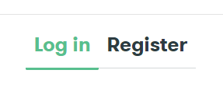
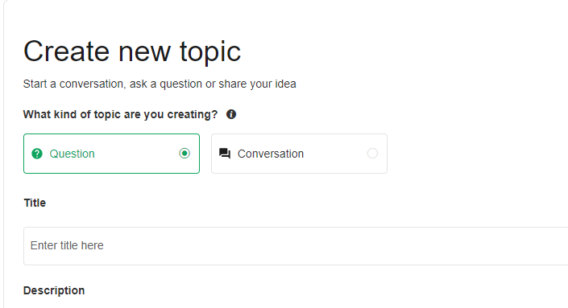
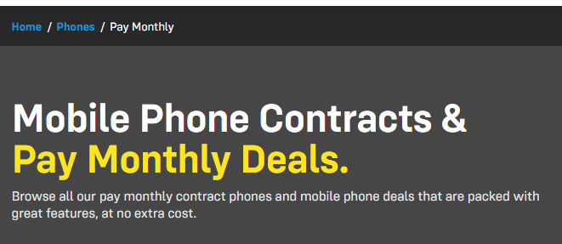
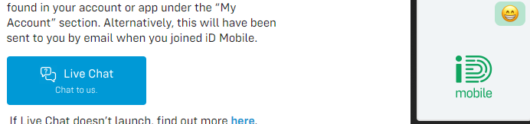
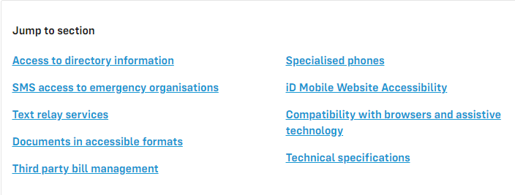
Features of a Website | https://idmobile.co.uk
Registration | This button (on the top right hand of the screen) is an action button dedicated to signing in / registering for an account.
Online Forums | With the iD Mobile website you can create a support form / topic on the community page to receive help from the iD Mobile community.
E-Commerce | E-Commerce on this website is buying mobile phones and sim cards.
Form | This form can be used to get support from an iD mobile customer support live chat .
Accessibilty | iD Mobile has many options to help people who need to use Accessibility options

Slide 9



Features of a Website | https://sky.co.uk
Hyperlinks | Sky has hyperlinks at the top of their page so you can find and navigate to things quickly.
Action Buttons | Sky has action buttons on the middle of their page. Action buttons are typically used to join a support chat, check your basket and to log into your account.
Template | Sky use a template of Red, Purple and Blue.
Email Links | Sky does not have any email links that I can find on their website.
Hot Spots | Hotspots are items such as logos that are hyperlinks but in image form.

Slide 10
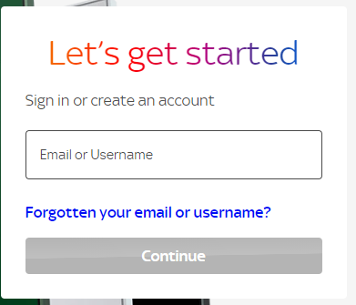

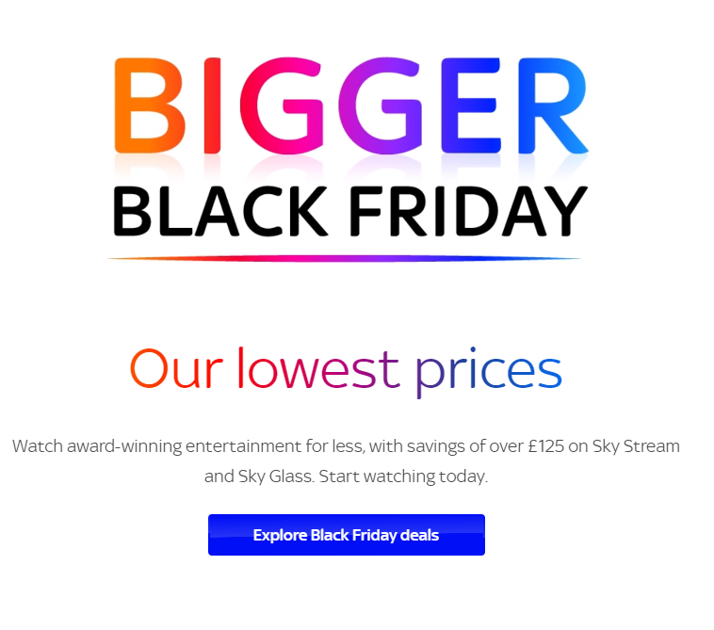

Features of a Website | https://sky.co.uk
Registration | Registration on this site is used to let you sign into your account to manage your bill, TV Code and to cancel or update your service.
Online Forums | Using the Sky assistant form you can get help for Sky Products.
E-Commerce | This advertising on the site is an example of E-commerce as the company wants you to buy in the black Friday sale.
Form | The search bar acts as the only form I can see on the Sky website.
Accessibility

Slide 11
Features | iD Mobile | Sky
Presentation | iD Mobile has a consistent layout of green and white (Gray and green with dark mode). Images are carefully placed and thought out trying to use the space as best as possible. | Sky has a consistent layout of white, blue and red. Images and buttons are placed throughout the site to catch your attention.
Usability | The iD Mobile webpage contains information about the phone you are buying and it does not contain anything else such as adverts etc. | The Sky website contains information about Sky products, they do try to advertise their own products to you that does get annoying sometimes and they litter their page with products.
Accessibility | iD mobile has accessibility for disabled users that use adaptive technology. | Unknown as blocked by firewall.

Slide 12
Purpose and Performance
Features | iD Mobile | Sky
Performance | iD Mobile loads its website quickly it switches to dark mode for the first split second before changing to your requested design. | Sky is slightly more sluggish when loading webpages compared to something like iD Mobile or chriswasntavailable.xyz but it still loads in an acceptable time.
Usability | The iD Mobile webpage has a good function by implementing an eCommerce platform, payment services and account services into one usable website. | The Sky website contains information about Sky products, It is not as easy to navigate as the iD Mobile website but it contains the same features.

Slide 13
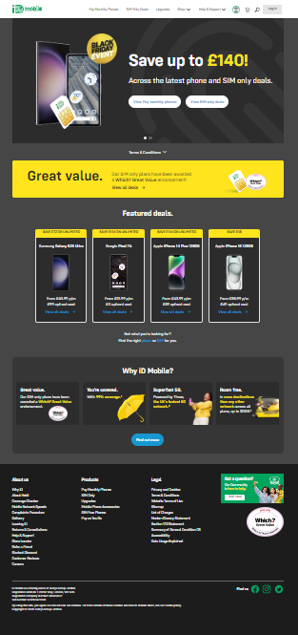
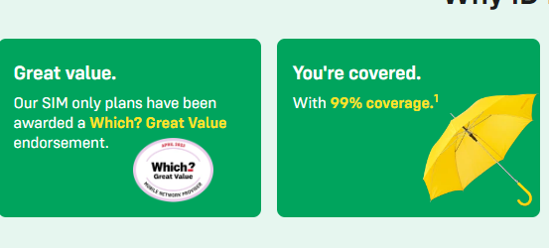
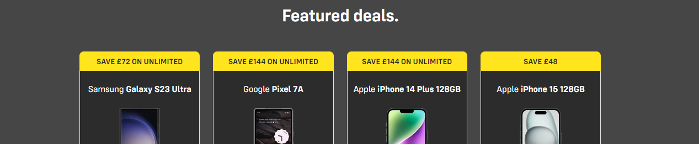
Strengths
Dark Mode
Simple Design
Easy to use website
Notes:
Colour Scheme: The colour scheme of iD Mobile is a basic white and green and is very recognisable when you know it.
Dark Mode: Dark mode is a nice feature to have as it helps users who are viewing the webpage at night or is sensitive to light to keep their eyes not overly stimulated.
Website Features: The website has everything you need to find all in one place. Generally you just need to look at the top menu / navigation bar to find what you are looking for.

Slide 14
Weaknesses
Hard to find live chat
No accessibility options built in
Every Page is not mentioned on the sitemap
Notes:
Live Chat: It would be nice if the live chat was located on a button on the home page or help page but you need to look deep into the help page to find it.
Accessibility Options: It would be nice if there were accessibility options built into the webpage instead of relying on something like Text to Speech that’s built into the operating system.
Sitemap: It would be good if every page is mentioned on the sitemap instead of just being part of the main “common” pages.

Slide 15
Improvements
Live Chat On Front Page
Add in Accessibility Options
More Detailed Sitemap
Notes:
Live Chat: It would be nice if the live chat was located on a button on the front page or in the help page but alas you need to look deep into the help page to find it.
Accessibility Options: It would be nice if there were accessibility options built into the webpage instead of relying on something like Text to Speech that’s built into the operating system.
Sitemap: It would be good if every page is mentioned on the sitemap instead of just being the main “common” pages.

Slide 16
Weaknesses
Animations on site are linked to scroll wheel speed
Accessibility Options are blocked by some firewalls
Hard to read text
Notes:
Animations: Animations on the Sky website are linked to the scroll wheel speed, that is not as people with broken scroll wheels or slow scrollers are placed as a disadvantage of not being able to see the animations Accessibility: The accessibility options on Sky are blocked behind some firewall. For the C2K firewall it is blocked for the reason “Shopping”.
Hard to read text: The Sky website contains some hard to read text as it is black text on top of a dark image etc.

Slide 17

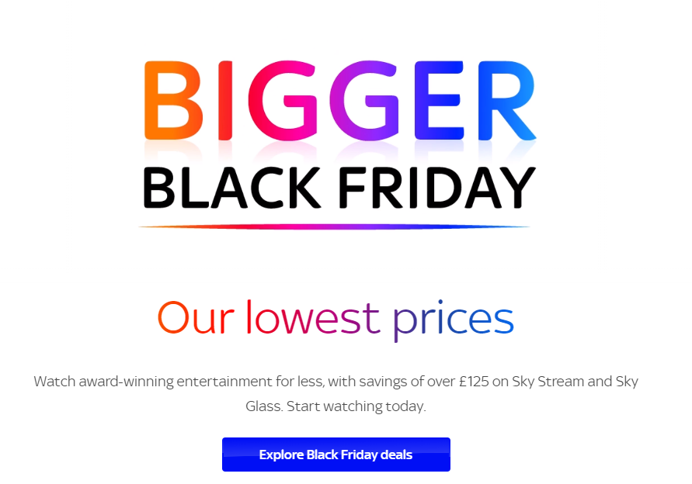
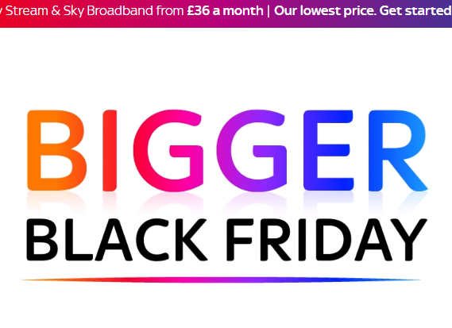
Strengths
Simple Colour Scheme
Options For Everyone
Updated Website
Notes:
Updated Website: At the time of this PowerPoint slide being made it is 21/11/23 meaning that black Friday sales have started and the Sky website has been recently updated to reflect that. Simple Colour Scheme: The Sky branding uses a gradient between orange and blue for its logos and advertising.
Options for Everyone: Sky offers items and services for everyone as they provide business broadband, Mobile contracts, TV, and home broadband.

Slide 18
Improvements
Link The Animation Speed To A Consistent Speed
Build The Accessibility Options Right Into the site instead of a secondary webpage
Move The Text so it doesn’t go over images
Notes:
Animations: Animations on the Sky website are linked to the scroll wheel speed, that is not as people with broken scroll wheels or slow scrollers are placed as a disadvantage of not being able to see the animations Accessibility: The accessibility options on Sky are blocked behind some firewall. For the C2K firewall it is blocked for the reason “Shopping”. This could be worked around by adding the accessibility options directly into the site
Hard to read text: The Sky website contains some hard to read text as it is black text ontop of a dark image etc. This would be fixed by making the text appear above the image

Slide 19
PowerPoint Map
Slide 1: The uses and features of a Website
Slide 2: What is a Website?
Slide 3: Uses of a Website
Slide 4: More uses of a Website
Side 5: ID Mobile
Slide 6: Sky
Slide 7: iD Mobile Features 1 slide 8: iD mobile features 2
Slide 9: Sky features 1
Slide 10: sky features 2
Slide 11: Strengths of id mobile
Slide 12: weaknesses of id mobile
Slide 13 Improvements of id mobile
Slide 14: strengths of sky
Slide 15: weaknesses of sky
Slide 16: improvements of sky

